Slide 1
Day 4

Slide 2
Agenda
SQLite in Android
SQLOpenHelper
Adapter
onCreate
onUpgrade
User defined Methods
ContentValues
DB Methods
24/05/2021
Basic Java
2

Slide 3
SQLite in Android

Slide 4

SQLite in Android
SQLite is a popular choice as embedded database software for local/client storage in application software such as Android Apps.
SQLite implements most of the SQL-92 standard for SQL.
SQLite is best for Android Apps which wants data to be stored in the phone.

Slide 5
SQLOpenHelper

Slide 6
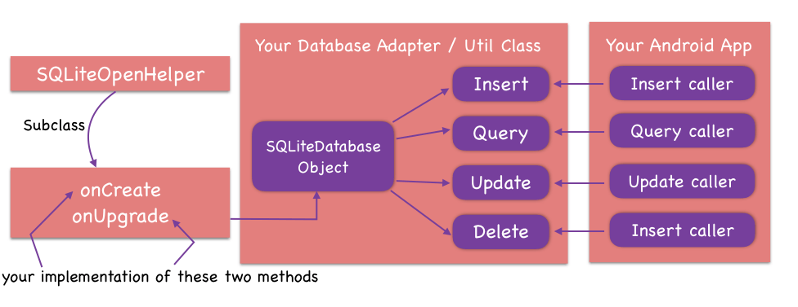
SQLOpenHelper
A helper class to manage database creation and version management.
Transactions are used to make sure the database is always in a sensible state.

Slide 7
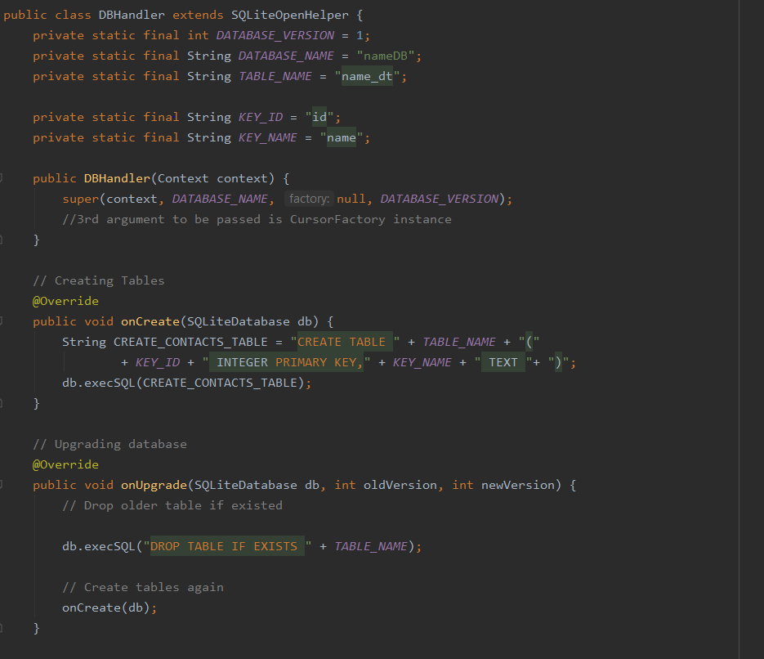
Database Adapter
Database Adapter is the intermediatory between the Helper Class SQLOpenHelper and Activity.
You create a subclass (i.e. Database Adapter) implementing onCreate, onUpgrade and optionally onOpen, and this class takes care of opening the database if it exists, creating it if it does not, and upgrading it as necessary.
Here, DBHandler is the DB Adapter.
Main Components of the Adapter
Adapter Constructor
onCreate
onUpgrade

Slide 8
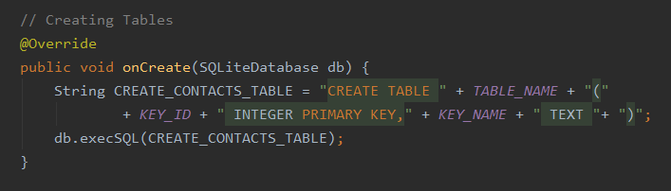
onCreate
Called when the database is created for the first time. This is where the creation of tables and the initial population of the tables should happen.
The parameter db is the SQLiteDatabase object which provides query execution, methods like getCount(),etc.

Slide 9
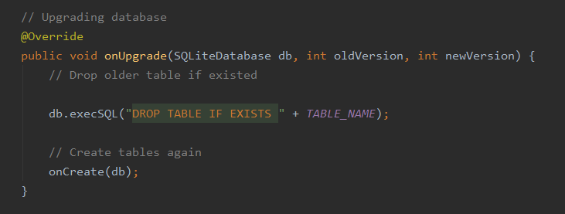
onUpgrade
Called when the database needs to be upgraded.
The implementation should use this method to drop tables, add tables, or do anything else it needs to upgrade to the new schema version.
When your app starts up, the helper does a check at runtime that your code's idea of the latest version is the same as the version which was active when the database was last created or upgraded.
If the numbers don't match, then the helper knows that the stored database is out-of-date with respect to your application code, and so it runs the upgrade routine.

Slide 10
User Defined Methods

Slide 11
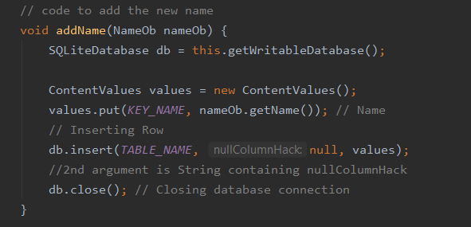
User Defined Methods
This methods are created by the programmer in order to give desired result.
In the shown picture, we developed addName() method for the sole purpose to add new Name to the database.

Slide 12
ContentValues

Slide 13

ContentValues
This class is used to store a set of values.
It works like a Dictionary which has collection of items consist of a key and a value.
For queries execution, we used it to transfer data to the database.
Note: Key which you assign with value must be column name of the table you will use.(See the code snip).

Slide 14
Db Methods

Slide 15
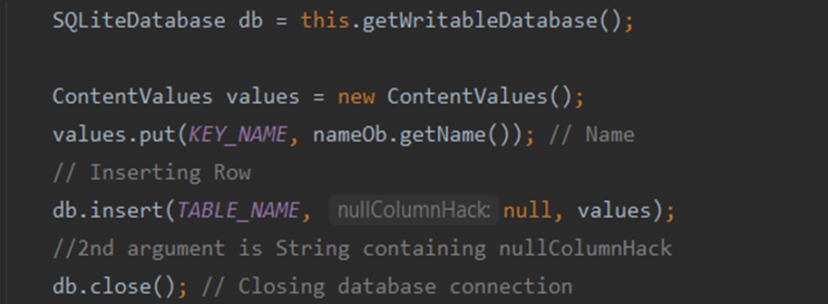
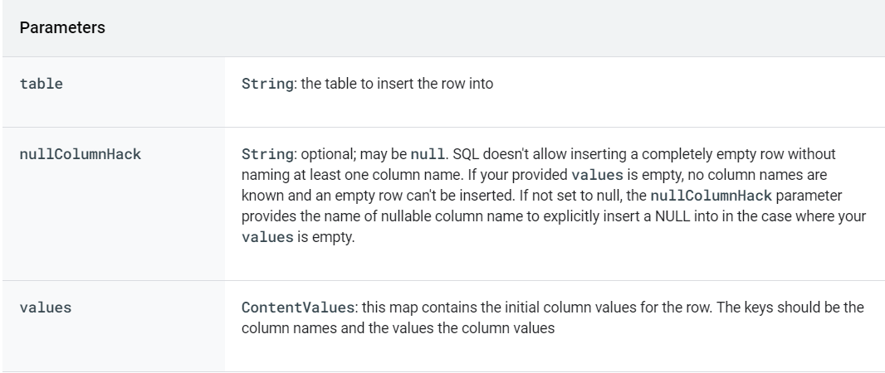
Insert()
The method is used to insert data into the table of the database.

Slide 16
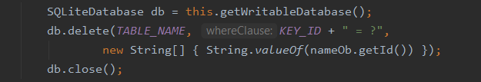
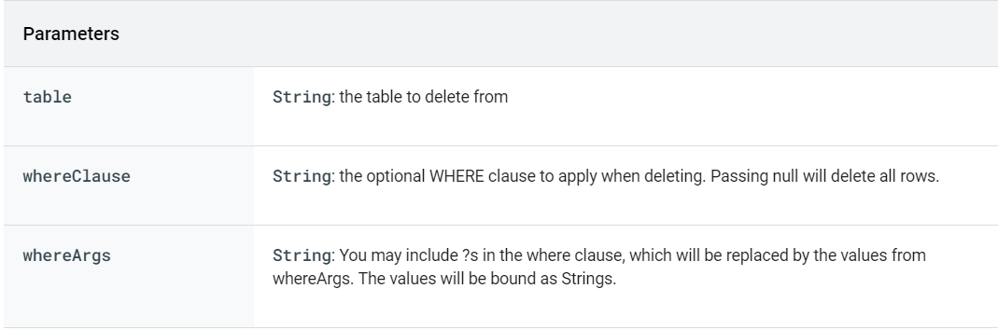
Delete()
This method is used to delete a row or rows of data.

Slide 17
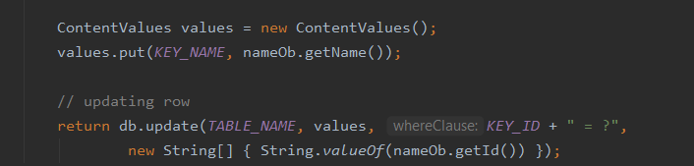
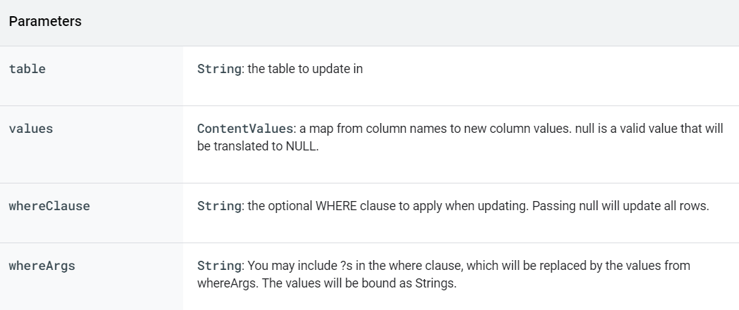
Update()
This method is used to update existing value or values in the database.

Slide 18
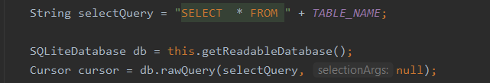
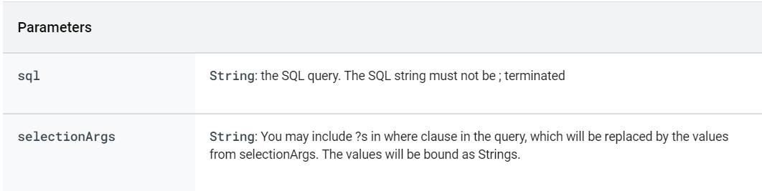
ExecSql() or RawQuery()
Both methods are used to execute SQL query.

Slide 19
Thank you

